Slide 1
Vaping
Lesson Plan for Schools and Young People's settings
Public Health & Wellbeing Department, South Gloucestershire Council
Notes:
Note for teacher: This lesson plan has been devised by a team of public health professionals with guidance from some teachers in South Gloucestershire. It can be adapted as you see best, however, please do not use the council logo should you add to the content. The original content is in line with public health messaging. An accompanying worksheet has been provided, along with a FAQ document and a video aimed at professionals working with young people.

Slide 2
Expectations
Respect each other's opinions
Only one person speaks at a time
No personal disclosure or gossip
Students can 'pass'
Use appropriate language

Slide 3
Learning Objectives
By the end of this session, you will be able to understand:
The reasons for vaping
The physical effects of vaping
The psychological effects of vaping
The effects vaping has on the environment
Notes:
All learners will be aware of basic physical risks associated with Vaping – 100%
Most learners will be aware of effects of mental health issues associated with Vaping – 80%
The effects on the environment
Some learners will acknowledge the involvement of organised crime including modern day slavery and child exploitation, and how this links to vaping –20%

Slide 4
Starter
Activity/discussion:
What do you already know about vaping?
List some words or phrases that come to mind onto post-it notes and pass to the teacher. You can also add these to your worksheet.
Notes:
Today we will learn: what vaping is, why people vape, the risks including physical and psychological, as well as environmental impacts
List some words/phrases/slang words that come to mind when you think about vaping or what do you know about vaping? (can be repeated again at end of lesson in hope of more understanding and knowledge)
Possible answers: cool, fun flavours/colours, Elf bar, geek bar, de-stress, friends, nicotine?
Can either do the worksheet individually or in a group, or have a class discussion with teacher reading out the post-it notes
Relevant sections on worksheet:
1. ‘What do you know about vaping?’ boxes
2. Word bank activity
The task at the end of the worksheet (Plenary/exit cards) will hopefully show understanding and knowledge increase

Slide 5
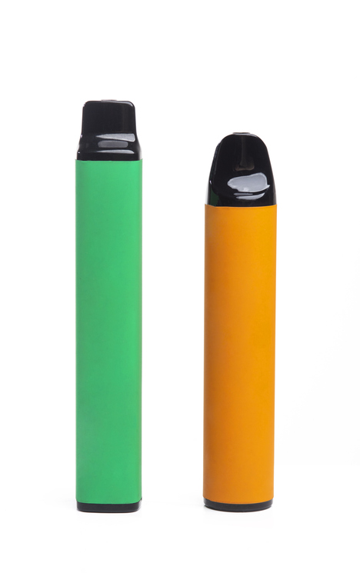
What are vapes?
A vape or e-cigarette is a device that allows you to inhale nicotine in a vapour rather than smoke.
Vapes do not burn tobacco and do not produce tar or carbon monoxide – two of the most harmful substances in cigarette smoke.
They were designed as a stop smoking tool for adults (18+)
Notes:
Vapes / E-cigarettes – may have heard of puff bars/Elf Bars/Geek bars
The actual reason for vaping is to stop smoking, however, many young people do so because of peer pressure, inquisitiveness, stress, social.
Vaping can help adults to stop smoking. They are not for young people. Although vaping is much safer than smoking, it is not risk free, particularly for those who have never smoked. If you don't smoke – don't vape.
Question – is it legal to sell or give vapes for under 18s? Answer: No, it is ILLEGAL.
Video on the next slide emphasises the message on this page.
Reference for information on slide- Quit Smoking Aids | One You South Gloucestershire (southglos.gov.uk)

Slide 6
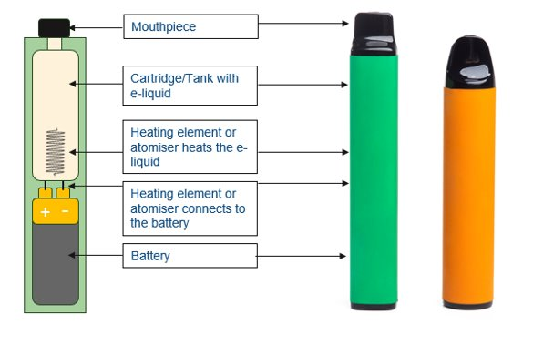
What is a vape?
Although vaping is much safer than smoking, it is not risk free, particularly for those who have never smoked.
If you don't smoke – don't vape.
Notes:
Reference for information on slide - Quit Smoking Aids | One You South Gloucestershire (southglos.gov.uk)

Slide 7
Vaping: The Facts (YouTube)
Notes:
Video 1min 38sec https://www.youtube.com/watch?v=rod4d4yFeaE

Slide 8
What does the law say?
Vapes should NOT be
Sold to anyone under 18
Bought for anyone under 18
It is a criminal offence to sell these devices to under 18s.
It is a criminal offence to purchase these on behalf of under 18s.
Should be sold with correct nicotine levels (under 2% or 20 mg) but often does not meet these regulations.
Notes:
Further info: often disposable vapes are sold to young people by peers who buy them online, or sometimes in shops. There are many counterfeit vapes for sale online and they have found their way to many shops. It is impossible to say how much nicotine, and what other health harming chemicals, there are in these illegal products.
Reference for information - E-cigarettes and vaping: policy, regulation and guidance - GOV.UK (www.gov.uk)

Slide 9
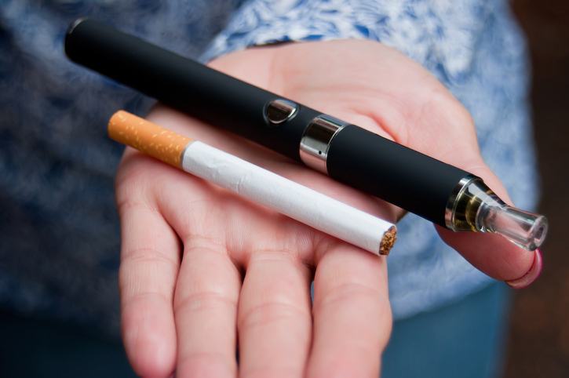
What is Nicotine?
Nicotine is a very addictive substance found in cigarettes.
Vapes can vary from no nicotine to high levels of nicotine.
Although much less harmful than smoking, vapes are not risk-free, especially for those who were never smokers.
Notes:
References for information in slide -
Tobacco Additives: Cigarette engineering and nicotine addiction - ASH
Quit Smoking Aids | One You South Gloucestershire (southglos.gov.uk)

Slide 10
Nicotine can have negative effects - what are they?
Complete your table on the worksheet to show the effects and discuss as a class.
Psychological/Behavioural | Physical
Notes:
Psychological/Behavioural: Increased anxiety, Depression, negative mood, problems concentrating,
Physical: Dizziness, lightheadedness, sleep disturbance, headaches if too much nicotine, coughing, dry mouth and throat, shortness of breath, changes in appetite
Withdrawal symptoms – aggression, moodiness, non engagement
Nicotine is a stimulant drug, which is why it can cause these issues, and reliance and dependence.

Slide 11
Inhaling nicotine through a vape can have negative effects
Physical changes
Coughing
Dry mouth and throat
Shortness of breath
Mouth and throat irritation
Headaches
Psychological changes
Negative mood
Behavioural changes
Problems concentrating
Increased anxiety
Depression
Notes:
These are similar to cigarette smoking. Nicotine is a stimulant drug, which is why it can cause these issues, and reliance and dependence.
Withdrawal symptoms – aggression, moodiness, non engagement, anxiety
REFERENCE
References for information on slides - Quit smoking - Better Health - NHS (www.nhs.uk)

Slide 12
What’s the problem with Vapes?
Long-term health impacts are unknown
Many counterfeit (fake / unofficial) products are in shops. Some may:
Exceed legal nicotine levels (Over 2% or 20 mg)
Contain too much liquid (over 2 ml)
Are incorrectly labelled and have no traceability
May contain banned substances
Illegal vapes are associated with organised crime, modern day slavery, child exploitation and fund other criminality
It is difficult to spot a fake vape!
Notes:
Exceed legal nicotine levels (Over 2% or 20 mg) higher doses of nicotine may be inhaled unknowingly
Links to organised crime for non regulated vapes including child exploitation, modern day slavery and fund drug crime e.g. children and young people are being exploited to sell vapes.
It is extremely difficult to spot a fake vape (i.e. unregulated). They have bar/QR codes etc. and often even a fake hologram. Many shop owners do not know they are selling counterfeit vapes.
Reference for information on slide -
Using e-cigarettes to stop smoking - NHS (www.nhs.uk)

Slide 13
What’s the problem with Vapes then?
Vape aerosol can contain harmful chemicals | Most vapes contain Nicotine which is highly addictive
The e-cigarette aerosol that users breathe from the device and exhale can contain harmful and potentially harmful substances, including: Nicotine Ultrafine particles that can be inhaled deep into the lungs Flavouring such as diacetyl, a chemical linked to a serious lung disease Volatile organic compounds Cancer-causing chemicals Heavy metals such as nickel, tin, and lead It is difficult for consumers to know what e-cigarette products contain. For example, some e-cigarettes marketed as containing zero percent nicotine have been found to contain nicotine. | Nicotine is an addictive substance and you can become dependent on vapes, especially if you vape nicotine regularly. Giving up nicotine can be difficult because the body has to get used to functioning without it. Withdrawal symptoms can include cravings, irritability, anxiety, trouble concentrating, headaches and other psychological and physical symptoms.
Notes:
Note – vaping is not known to cause popcorn lung as the amounts of diacetyl are so small (https://www.cancerresearchuk.org/about-cancer/causes-of-cancer/does-vaping-cause-popcorn-lung)
References for information on slide -
About Electronic Cigarettes (E-Cigarettes) | Smoking and Tobacco Use | CDC
E-cigarette use or vaping: reporting suspected adverse reactions, including lung injury - GOV.UK (www.gov.uk)
Vapes | FRANK (talktofrank.com)

Slide 14
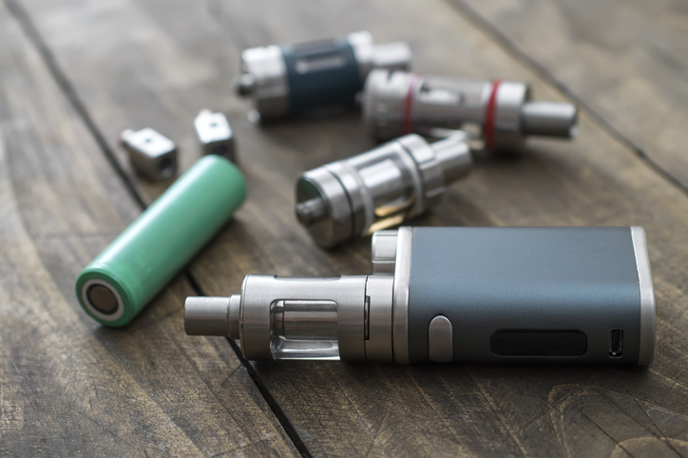
How do I refuse a vape?
Join your small groups
Discuss exit strategies and how you would refuse a vape when you don’t want one
Write the best ‘refusals’ on your worksheet
Notes:
The purpose of this slide is to help young people verbalise and practice their reasons for not vaping when offered.

Slide 15
Smart Exit Strategy Examples
Simply say, ‘No thanks, I’m good’
Stand with your non vaping friends
Suggest something else to do
Give your reasons for not wanting to use a vape
Add some humour
Practice your response before it happens
Giving vapes to under 18s is against the law
Notes:
Teacher's notes: Role play could be appropriate in small groups?

Slide 16
Activity suggestion 2 – Refusal Skills Practice
Form a circle
Toss the ball to each other
When you receive the ball, give a unique refusal to remain standing

Slide 17
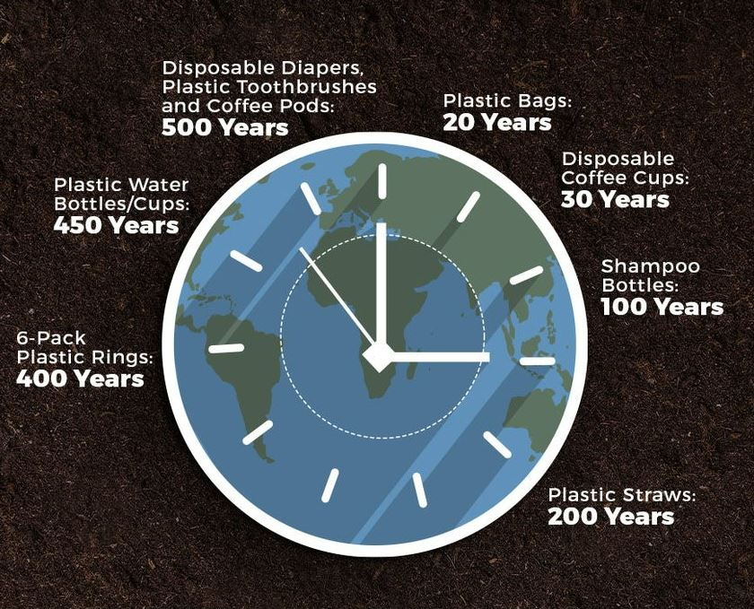
Environmental Impact
A million disposable vapes are thrown every year in the UK - this equates to 10,000kg lithium from the batteries, enough to power 12,000 electric cars every year.
Plastic doesn't decompose. Plastic breaks down into smaller particles until they are too small to see. This means that every molecule of plastic produced since 1907 is still present in the environment!
Notes:
References for facts: How Long Does It Take for Plastics to Biodegrade? | HowStuffWorksAnd Environmental impact of disposable vapes revealed | Science & Tech News | Sky News
Picture References:
Earth Day 2021 x2 pictures: No Way to Safely Dispose of Plastic Vape Waste — CYANOnline
How long till they're gone graph: reference at bottom of picture
Plastic generation and recovery (recycling rate – whilst recycling efforts have improved over the past few decades, the gap between plastic recovery and generation continues to widen): Close the Loop Provides Insight into Recent EPA Fines (prweb.com)

Slide 18
Environmental Impact
Although most plastics never decompose, they do eventually break down into smaller and smaller pieces called microplastics. *
For anything to decompose fully it needs to be eaten by micro-organisms. Most micro-organisms don't like plastic, and for those that do, there is simply too much plastic for them to eat.
Tesco have started recycling vapes
Notes:
Fish will actively digest microplastics in addition to consuming them via their diet. Although ingestion of the microplastics does not appear to have negative impacts on the health of adult fish, at least in the short term, the results indicated changes in body condition of larvae which are currently unexplained. - Environment Agency – UK Link here Future of the sea: plastic pollution - GOV.UK (www.gov.uk)
Seahorse with plastic cotton bud: This Heartbreaking Photo Reveals a Troubling Reality (nationalgeographic.com)
https://www.tescoplc.com/sustainability/documents/policies/our-approach-to-managing-waste-from-our-uk-operations/

Slide 19
OK – so is this really a problem for young people?
What percentage of 11–17-year-olds have tried vaping in 2022?
What percentage of 11–17-year-olds were current users in 2022?
15.8%, compared to 11.2% in 2021 and 13.9% in 2020
7.0%, compared to 3.3% in 2021 and 4.1% in 2020
Notes:
Many young people typically give much higher figures. Ask the class to write answers on a post it note
Below data from ASH 2022: Use of e-cigarettes among young people in Great Britain - ASH
A large majority of 11-17 year olds have never tried or are unaware of e-cigarettes (83.8%)
In 2022, 15.8% of 11-17 year olds had tried vaping, compared to 11.2% in 2021 and 13.9% in 2020
In 2022, 7.0% of 11-17 year olds were current users (at the time of survey), compared to 3.3% in 2021 and 4.1% in 2020.

Slide 20
93% DON'T VAPE! Perhaps it is not as 'cool' as people think??
Percentage of 11-17-year-olds vaping
Notes:
Not as common for CYP to vape as is imagined. You are not alone or unusual in not choosing to vape.
A large majority of 11-17 year olds have never tried or are unaware of e-cigarettes (92.2%)
In 2022, 15.8% of 11-17 year olds had tried vaping, compared to 11.2% in 2021 and 13.9% in 2020
In 2022, 7.0% of 11-17 year olds were current users, compared to 3.3% in 2021 and 4.1% in 2020.
93% DON'T VAPE! Perhaps it is not as 'cool' as people think??

Slide 21
Recap
Discussion or Plenary/exit card activity from worksheet:
Why do people vape?
What are the advantages of vaping?
What are the risks to young people vaping?
What are the environmental impacts?
Notes:
PLENARY
Reasons to try e-cigarettes
YOUNG PEOPLE: To be accepted by friends/Just curious/To taste the flavours/To rebel or appear older/Feeling stressed
ADULTS: to help them to stop smoking cigarettes
The only advantage of vaping is to relieve the craving of smoking when you are trying to stop.
Vaping creates nicotine cravings just like when you smoke. If you don't vape you won't feel the cravings nicotine causes which include
Negative Mood and behaviour changes
Problems concentrating
coughing
dry mouth and throat
shortness of breath
mouth and throat irritation
Headaches
Anxiety

Slide 22
Where to get help …
Teacher
School Nurse
GP
Parent / guardian
Vapes | FRANK (talktofrank.com)
Smokefree South Gloucestershire Quit Smoking Services | One You South Gloucestershire (southglos.gov.uk)
Further information on a wide range of topics for young people can be found here Young people | South Gloucestershire Council (southglos.gov.uk)

Slide 23
Quick teacher survey
Public Health and Wellbeing would appreciate feedback on this lesson. Please follow the link below. It should take you no more than 60 seconds to complete
https://online1.snapsurveys.com/interview/75fa70c9-daca-4bca-98e7-91f26f128548

