Slide 1
Creative Solutions Project: Next steps
Nicola Street
Creative Solutions Coordinator
Creative.solutions@southglos.gov.uk

Slide 2
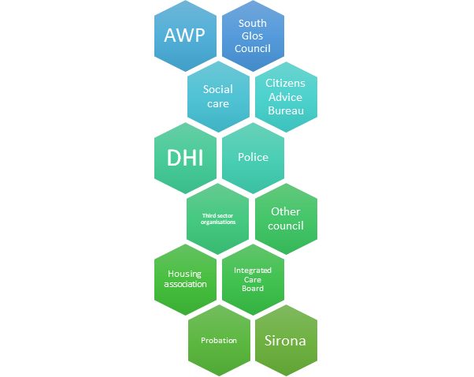
Key themes from evaluation
Engagement with the project:
Sept 2022-March 2024: 47 referrals, 9 cases discussed at CSB
Broad range of organisations represented at board level

Slide 3
Referral sources

Slide 4
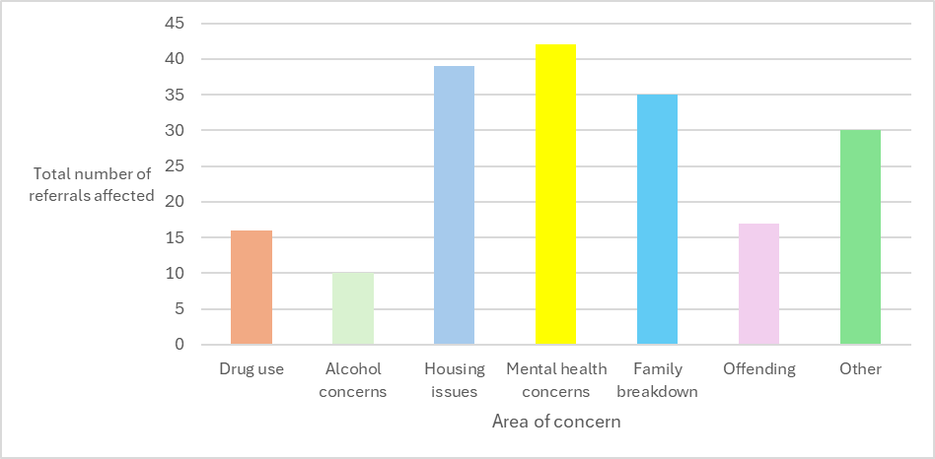
Reason for referral: area of concern
Area of concern: | Drug use | Alcohol concerns | Housing issues | Mental health concerns | Family breakdown | Offending | Other*
Number of referrals affected: | 16 | 10 | 39 | 42 | 35 | 17 | 30

Slide 5
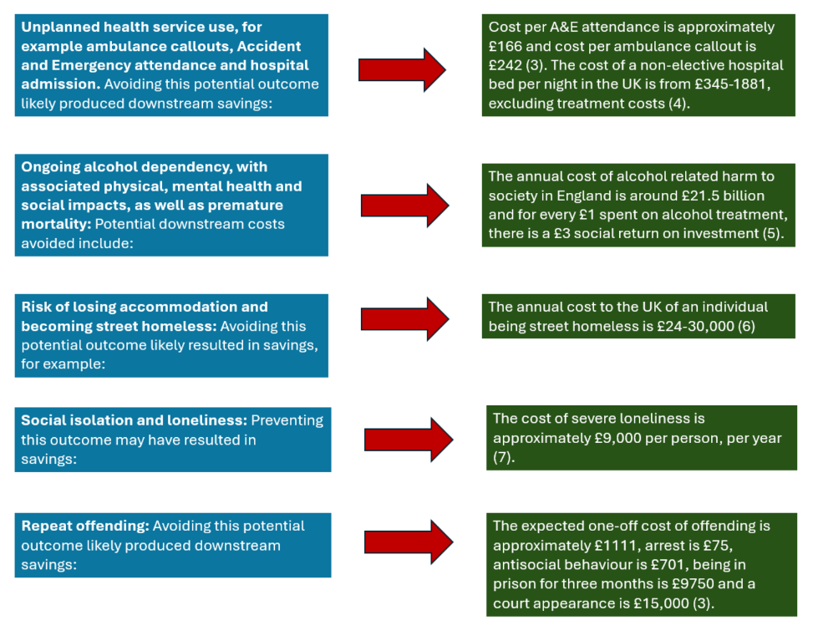
The positive actions from the project likely averted multiple downstream consequences for clients including the below examples

Slide 6
Key themes from evaluation
Summary of key findings:
Impact of project on individuals:
Demonstrably positive outcomes for individuals in South Glos, including improved access to healthcare services.
This has likely averted multiple negative downstream outcomes such as social isolation, risks of street homelessness and unplanned health service use, resulting in a wide range of probable cost savings made across the system.
Impact of project on organisations/teams:
Evidence of organisational change and development for teams involved, including a change in communication approaches and enhanced networking across organisations.

Slide 7
Key themes from evaluation
Impact of project on wider system:
Enabled early action, likely producing cost savings downstream.
The system was also strengthened by risk and responsibility sharing, and the project represented a catalyst for change when the system was faced with complexity.
Importance of coordinator
The project coordinator has been highlighted as a vital “connection point” between organisations, driving wider system change and demonstrating transformative leadership.

Slide 8
Examples of recent cases – AB
Complex history of past trauma, poor mental health including, OCD, Anorexia and Emotional Unstable Personality Disorder. - average cost of service provision for adults suffering from any type of mental health disorder, excluding dementia, per person per year £1,180 (1) (NHS costs)
Multiple evictions due to alcohol dependency, poor mental health and multifaceted behavioural complexities, difficulties in finding housing provided that would accept her due to her past evictions - Adults living with severe multiple disadvantages (SMD) - involvement in homelessness substance misuse and criminal justice – average annual fiscal cost £26,814 (2)
Street homeless – The annual cost to the UK of an individual being street homeless is £24-30,000 (3).
Multiple assaults leading to admission whilst living on the street, frequent engagement with police and community safety team– Crime: violence with injury - average cost per incident £3,957 (4)
Frequent ambulance call outs leading to hospital admissions, concerns over LM’s high risk of death . - ambulance services - average cost of call out: seeing, treating and conveying patients, per incident £368 (5) -hospital inpatient admission - average cost per episode (elective and non elective admissions) £3,030 (6)
Fluctuating engagement with services, self-neglecting behaviours not eating or washing, unable to manage finances .
Screened into safeguarding and ongoing support from Social Worker and frequent support from and engagement with Community Safety Team.
These are best estimates based on the below sources, this is likely to be a considerable underestimation due to the high complexity and intersectionality of this case
3,Evidence review of the costs of homelessness
1,2,4,5 Research: Cost Benefit Analysis - Greater Manchester Combined Authority
Notes:
This is likely to be a vast under-estimation of this individuals cost to the systems as a whole. This is the best estimate based on available evidence which is an average . Where sourced from the greater Manchester combined authority Research: Cost Benefit Analysis - Greater Manchester Combined AuthorityThis is using the fiscal costs – costs or savings that fall to public sector agencies and relate to public expenditure.
They do not include the economic value – costs or savings that fall to individuals, employers or wider economy nor do they include the social value – wider gains to individuals and/or society, such as improvements in health and wellbeing e.g. reduced crime.

Slide 9
AB outcome following CSB
After the coordinator's exploration of best practices and available learning, a multi-agency risk assessment was developed and implemented. This comprehensive document allowed all services to collaboratively identify, mitigate, and manage risks in a single shared format. The risk assessment played a key role in supporting AB’s housing application by demonstrating the coordinated efforts of various services and professionals involved. This approach enhanced collaboration across agencies, ensuring that no single individual or service felt solely responsible for managing the risks. Since AB was housed, the risk assessment has been regularly reviewed, most recently to assist the supported living provider in managing AB’s risks and behaviours while mitigating potential risks to others within the accommodation.
The PH specialist housing practitioner collaborated across services and worked closely with commissioning to identify and secure specialist supported living that focuses on addiction and mental health needs. Importantly, this accommodation is not a dry house, enabling tailored support for AB. This approach has significantly reduced AB's risk of death, with a multi-agency team in place to help manage and monitor AB’s alcohol dependency, including a controlled reduction in drinking and support for self-neglect.
This is the longest period AB has remained successfully housed. There has been a notable reduction in police involvement, alongside ongoing collaborative planning to further reduce ambulance calls and hospital admissions. Social worker has been able to conclude their involvement.

Slide 10
Examples of recent cases – CD
Complex history of past trauma including neglect and sexual assault : other sexual offences – average cost per incident £1,793 (1)
Poor mental health including; anxiety, depression, self-harm, diagnosis of emotionally unstable personality disorder and auditory and visual hallucinations : average cost of service provision for adults suffering from any type of mental health disorder, excluding dementia, per person per year £1,180 (NHS costs) (2)
Large volume of contacts to police 2023 around16 incidents, 2024 around 53 most as a result of behaviours associated with poor mental health.
Frequent self-harming and has been detained as an inpatient and taken to a place of safety on numerous occasions : Cluster 14: Psychotic crisis, Unit cost per occupied bed day £396.39 (3)
Multiple evictions due to poor mental health and associated diverse behavioural complexities being deemed as ‘high risk’ evicted from 4 accommodations in 2024, difficulties in finding housing alternative housing leading to homelessness : Adults living with severe multiple disadvantages (SMD) - involvement in homelessness substance misuse and criminal justice – average annual fiscal cost £26,814 (4)
Street homeless, living in a graveyard and 3 homeless applications : Homeless application – average one off and on-going costs associated with statutory homelessness £3,189 (5) :- The annual cost to the UK of an individual being street homeless is £24-30,000 (6)
2 years of social worker involvement.
These are best estimates based on the below sources, this is likely to be a considerable underestimation due to the high complexity and intersectionality of this case
1,2,4,5: Research: Cost Benefit Analysis - Greater Manchester Combined Authority
3: Microsoft Word - Mental Health Housing and the Acute Care Pathway and economics V2[2].docx
6: Evidence review of the costs of homelessness
Notes:
This is likely to be a vast under-estimation of this individuals cost to the systems as a whole. This is the best estimate based on available evidence which is an average . Where sourced from the greater Manchester combined authority Research: Cost Benefit Analysis - Greater Manchester Combined AuthorityThis is using the fiscal costs – costs or savings that fall to public sector agencies and relate to public expenditure.
They do not include the economic value – costs or savings that fall to individuals, employers or wider economy nor do they include the social value – wider gains to individuals and/or society, such as improvements in health and wellbeing e.g. reduced crime.

Slide 11
CD outcome following CSB
Colleagues from Bristol AWP agreed to take a flexible approach to support relationship building to bring CD back into the appropriate structured clinical pathway now regularly engaging with support sessions.
Specialist PH Housing practitioner worked across the system to identify and source specialist supported living who specialise in Mental health, this has enabled CD to have stable housing and support from staff who understand and work with CD in a trauma informed way as such CD is now learning independent skills which will enable them to live independently in the future, gaining more confidence in accessing the community and services which will support their physical and mental wellbeing.
CD has had intensive social work involvement for 2 years following on from the above CD no longer requires this level of input, SW has completed a review of CD’s care and support and CD is due for a review in 1 year.
There has been no further contacts with police
No new mental health crisis calls, or emergency interventions have occurred.

Slide 12
Next steps and the future
How will you embed learning and creative practice for the practitioners in your teams?
How will you systematically address system blocks and thematic issues to allow for creative solutions?

