Slide 1
Child Sexual Exploitation (CSE)
This won’t happen to me!
Notes:
TEACHER’S NOTES
This presentation is aimed at all year groups, it should take no longer than 20 minutes.
It’s intended that slides 5, 6 and 7 should be used again in smaller class/group discussions.
There should be good visual signage in school of how to ask for help – display the South Gloucestershire posters and keep parents informed using the postcard to hand out to them at parents evenings and so on.

Slide 2
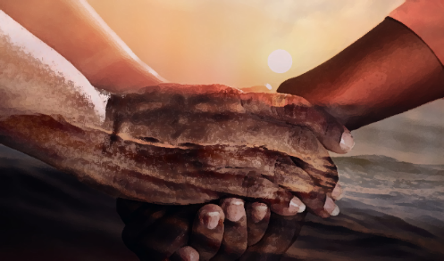
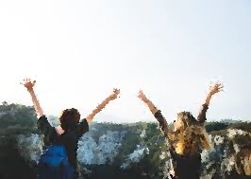
Healthy relationships
Notes:
Start by asking the pupils to consider what qualities and actions make for a healthy relationship – this can include all friendships not just girl/boyfriend or sexual relationships
e.g.
Equal and caring – discussing things, making decisions together, being fair
Connecting and supporting – helping out when things are tough, listening, sticking up for each other, believing in each other
Nurturing – being positive and truthful, addressing differences of opinion without anger, supporting hobbies, taking an interest
Secure and safe – trusting, truthful, honest, reliable, consistent
Communicating – regularly, face to face
Joy and adventure – having fun, planning things together, trying new hobbies

Slide 3
Notes:
Ask the pupils to consider the opposite of a healthy, nurturing, respectful, caring, consenting relationship.
e.g. an unequal distribution of power and/or an inappropriate relationship.
What does this this look like – behaviours etc. next slide gives some examples…...

Slide 4
Who you talk to…
Who you meet up with…
Where you go…
When you go out…
What you do…
What you wear…
Notes:
Ask the question:
Is if fair/healthy that someone you are in a relationship with can have this much control or power over you, your decisions, your lifestyle?

Slide 5
What’s this got to do with CSE?
CSE is the control of a child or young person through force, threats or manipulation and is a type of sexual abuse. This process is called grooming.
Children and young people can be ‘groomed’ online or in the real world, by a stranger or by someone they know.
Notes:
Go through the definition on the slide and make clear that CSE is happening everywhere, in all sorts of ways. Have they heard anything in the news or any TV programmes about it?
Reinforce that CSE an happen to anyone! This makes more sense by going through the next slide.
Discussions in the classroom can be supported by showing the following clips – please watch them first to make sure they are age/maturity appropriate:
Online Grooming
Kayleigh’s Love Story, https://youtu.be/WsbYHI-rZOE - A film produced by Leicestershire Police to warn children and parents of the dangers of online grooming
BLAST Project
Alright Charlie - https://youtu.be/UGEgn767XAk - A new free resource is available from the BLAST project for LSCBs aimed at raising awareness of CSE and grooming in primary school aged children (could also be used with pupils with SEN)

Slide 6
The Grooming Line
Becoming ‘unloving’
Withdrawal of love
Isolation
Manipulation
Threatening
Physical violence
Giving drugs
Making you have sex with other people
Observing
Selecting
Befriending
Gaining trust
Making you feel special
Giving gifts
Spending time with you
Listening
Being there
Keeping secrets
Offering protection
Being your girlfriend/boyfriend
Establishing a sexual relationship
Engaging in forbidden activities
Being inconsistent
Notes:
This can be covered briefly in the assembly and also a focus for a follow up session. The full version of the Grooming Line is included in the campaign web page as a resource to guide you.
If this process was happening to a friend what behaviours might you notice? What could / should you do? Would this be betraying your friend’s trust?
The Children’s Society use the following to raise awareness of what CSE is:
Different types of grooming
1. Inappropriate relationships – usually involving one perpetrator who has inappropriate power or control over a young person due to being physically stronger, older o wealthier. Can include familial abuse, when an older family member exploits their child or sibling. Someone else may be threatening and forcing them to do this, or they may have mental health problems, drug or alcohol dependency or a previous experience of exploitation themselves.
2. Adult (or referred to as the ‘boy/girl friend model’) – the adult offender of CSE befriends the young person, focussing on their vulnerabilities. The victim will initially feel they are in a positive and rewarding relationship. Power and control leads the to being isolated and becoming dependant on the boy/girl friend. Often coerced or forced into sex with the perpetrator’s associates.
3. Trafficking – young people are passed by perpetrators through networks, between towns and cities where the may be forced or coerced into sexual behaviour with multiple people. These young people are often used to ‘recruit’ other young people. Can be part of much wider organised crime.
4. Peers – This type of CSE is often referred to as sexual bullying. It can happen quickly without the grooming process. Incidents may be filmed on mobile phones and circulated or occur publically or involve multiple perpetrators.
Over a quarter (28%) of perpetrators identified in the recent ‘Inquiry into Sexual Exploitation’ (Office of the Children’s Commissioner), in gangs or groups were under 19.
5. Party Model - Groups of young people might be invited to parties, which can seem exciting, but the party organisers are not actually kind friends, they want to get young people drunk so they can have sex with them

Slide 7
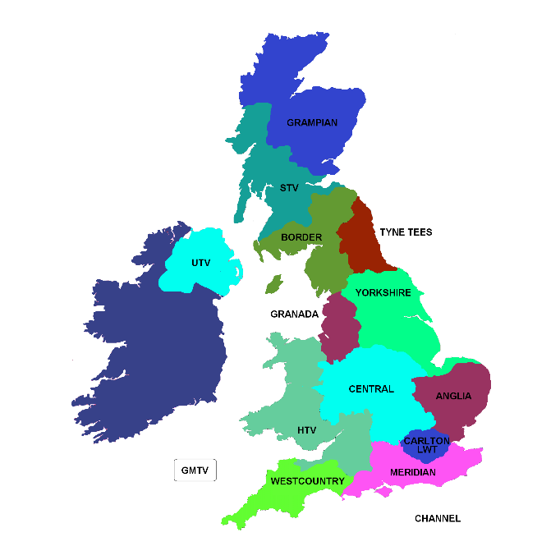
Myth busting
It won’t happen to me, right?
Notes:
Time permitting go through these statements for students to think about – these can be reinforced in more detail in a class/small group follow up session:
CSE….
Only happens to girls
Only happens to older teens
Only happens in cities, up North, in poor areas etc.
Only happens to children and young people from poor families, not very educated families etc.
Only happens online
Are there other myths?
However, many perpetrators will seek out people with certain vulnerabilities e.g.:
Chaotic household
Living in care
Low self-esteem or low self-confidence
Recent bereavement or loss (break up form a partner)
History of abuse
Homelessness
Learning disabilities
Unsure of sexuality
Lack of friends
We can learn to protect each other too!!!
Warning signs and behaviours to look out for e.g.:
Missing from home / care
Physical injuries
Truanting from school
Change in physical appearance
Secretive
Lots of new things (received as gifts)
Secretive
Involved in offending
Recruiting others into exploitation

Slide 8
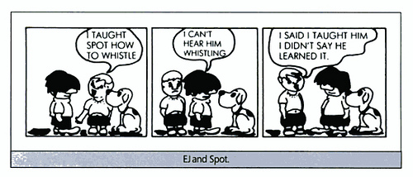
What do you need to learn – to know about, to understand, to recognise – so you can all keep each other “CSE” safe?
Notes:
Ask the pupils to think about protective skills that can be developed:
e.g. observing changes in behaviours, listening to your gut feelings, thinking about the consequences of posting personal info online etc.
The following can make a difference – check security settings on social media sites used frequently, think about what is posted online, know who there is to talk to when worried, know where to ask for help and know that keeping secrets is helpful to a CSE perpetrator!

Slide 9
Notes:
Finally go through your school’s procedures for who pupils can talk to and where they can get help (see next slide and add details) – what might the barriers be to getting help, either for themselves or a friend?

Slide 10
Talk to someone
Add school support details here
Notes:
If you’re worried about you or a friend, talk to someone you trust (add individual school support details here:
student support / school messaging system / school email address / school health nurse drop-in session etc. for confidential support and advice).

Slide 11
LOOK, LISTEN, ASK, ASK AGAIN, BE CURIOUS...
You can also: call the Council on 01454 866000 or the Police on 101 to talk things through.
If you’re in immediate danger outside of school, dial 999 straight away.
To find out more about CSE visit www.southglos.gov.uk/CSE

