Slide 1
EVERYDAY
CONSENT
Notes:
Slide 1
NOTES
This presentation and the activities supporting it are designed for years 6 and 7, (you may decide to use with year 5, if appropriate and that is for individual schools to decide). There is a separate Consent/CSE presentation for years 8 – 10 accessed here: www.southglos.gov.uk/CSEcampaign2018
There are other lesson plan ideas here too - https://learning.nspcc.org.uk/research-resources/schools/making-sense-relationships/
Please go through all the slides and notes (and watch the 2 video clips prior to using with your pupils)
It should be carried out as part of a PSHE lesson and may support other teaching and learning on relationships that has happened or is planned for the summer term.
It aims to raise awareness in the following areas of relationships:
the characteristics of all sorts of relationships (romantic, family, friendships), including mutual respect, truthfulness, trustworthiness, loyalty, trust, sharing interests and experiences and support with problems and difficulties.
that healthy relationships (and friendships) are positive and welcoming towards others, and do not make others feel lonely or excluded.
the importance of permission-seeking and giving (consent) in relationships with friends, peers and adults.
It does not cover on-line relationships, but will link strongly with teaching and learning about online safety.
For year 7, you may want to introduce this in a year group assembly, in which case we suggest you show all the slides, and then carry out the activities on slides 5, 7, 9, 10 and 11 in a PSHE lesson or in small groups.
Points to consider prior to using this presentation:
Please ensure there is good visual signage in school, and remind the children throughout the presentation, of how children can ask for help and the trusted adults who can help them.
Some children may have examples of relationship behaviours that are unhealthy or abusive, they may have been told these behaviours are ‘ok’, ‘normal’ or something that ‘everyone does’ – i.e. like being forced to keep secrets, being stopped from seeing certain people because ‘they aren’t nice’ etc.
Children may use the example of keeping secrets. This is a difficult concept to explain in terms of giving consent to keep a secret. You may want to explain that some secrets may be really harmless, like keeping a surprise party a secret from a family member, whilst other secrets can be unsafe, especially if someone suggests not keeping something a secret will bring harm or is used as a threat. Please use your CP/safeguarding ‘hat’ here if this discussion arises.
Use your usual PSHE ground rules or Jigsaw charter to create a safe learning environment.
You may wish to inform parents prior to running this session, using your usual forms of communication.

Slide 2
WHAT IS EVERYDAY CONSENT?
To say...
Yes!
To say...
No!
To say...
Yes, but..!
Notes:
Slide 2
Quick hands up to the question ‘What is consent?’ to gauge current knowledge.
Then, to illustrate this further, ask children to stand up, ask one of the questions below and ask children who don't consent to this, to sit down. This is a really visual and quick representation of asking for, giving or not giving consent in action.
Do this two or three times:
Can I use your pen?
Can I have a drink from your water bottle?
Can I hold your hand?
Please also discuss none verbal giving or not giving consent, and that not saying ‘No’ is not the same as saying ‘Yes’ – this will also be discussed through other slides and activities as well as issues such as:
Saying Yes, but with conditions...
And, changing your mind....

Slide 3
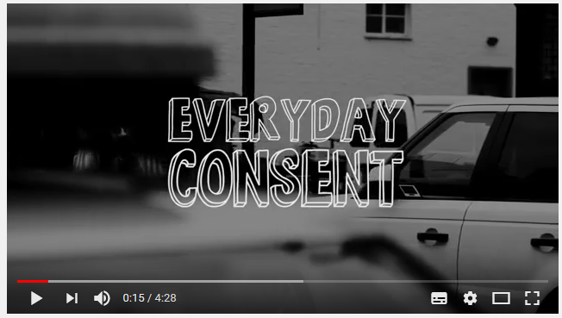
Notes:
Slide 3
Video clip 1 – Everyday consent.
Recapping discussions so far.
This video is just under 4 and a half minutes and explains the concept of consent in everyday life.
You may want to pick up on the idea of saying ‘Yes, with conditions’ and this is also mentioned on slide 6.

Slide 4
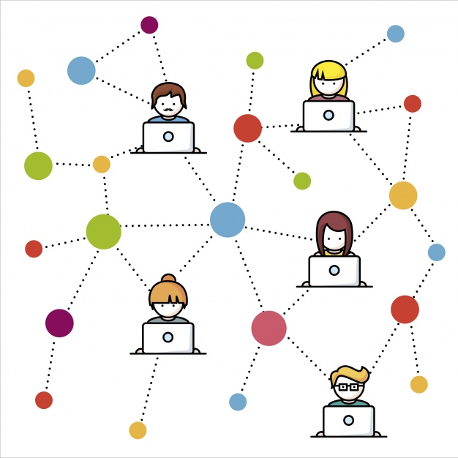
WHAT TYPES OF RELATIONSHIPS HAVE YOU HEARD OF?
You could think of a relationship as the way in which two or more people are connected.
Notes:
Slide 4
This slide a very quick reminder of any pre learning and intended to get children thinking about the sorts of relationships they may know about already, or have heard about. Volunteered ideas could be written on a flip chart or on post it notes and displayed as a reminder.
You may want to ask if we also have a relationship with ourselves?
Some different kinds of relationships:
•Family – your family is not just your parents or carers and your brothers and sisters it is also all your ‘rellies’ [relatives] - like grandparents, aunts, uncles and cousins. You may or may not live with them; you may get along with them or have massive fights; you may never have met them, or they may be your best friends. They may also include people you call auntie or uncle but who aren’t actually related to you.
•Peers / Friends / others in your class or school, or at clubs you go to - some might be your closest mates; others might be people you don’t like at all.
•People at school, or maybe work - you might not want to hang out with them but they are there.
•Your best friend - he or she could be your best mate, or sometimes the person who gets to you most!
•Your neighbour, your doctor, your postie, your sports coach - you might meet regularly or never meet – we all have a relationship with others in our community.
•People in your interest groups - sports teams, music, drama, art or youth groups. You all share an interest but that doesn’t mean you will be “Besties”
Names of relationships:
Boy friend
Girl friend
Romantic
Marriage
Partner
Professional – teacher etc.

Slide 5
WHO’S IN YOUR CIRCLES?
Who do you have relationships with? The people in the closest rings to you are the ones who are most important to you
me
trusted adults (grown ups you can trust)
neighbours, school staff
other people who help you
people you don’t know
family, friends, relatives
Notes:
Slide 5
This slide can be a very quick visual reminder of all the different people we have relationships (and friendships) with. It may build on previous learning of relationships (e.g. through PSHE/Jigsaw).
Children can think of examples to the question on the slide - Who do you have relationships with? (The people in the closest rings to you are the ones who are most important to you.) Some examples are given as prompts. And to start discussion.
Using the term ‘Trusted Adults’ consistently across all schools would be good – making sure children understand this term is key.
Activity
Give out a copy of the ‘circles diagram’ on the slide and pupils can compete their circle of trust. You can discuss similarities and differences.
Linking this with everyday consent...
Depending on the maturity of the pupils you can also talk about which circles contain the people they think its OK to give a hug to or to receive a hug from or hold hands with. You can link with online safety here - given that many children have smart phones, ask about who is it ok to receive messages / friend requests from, and who is it ok to share images with?)
Once populated with ideas ask the children to consider what types of relationships there are?
e.g. romantic, family, friendships (in the friend, people you don’t know sections, will reference be made to ‘friendships’ people develop or have with people they’ve never met – i.e. through gaming platforms etc.). People you call auntie or uncle but who aren’t actually related to you.
You can also reinforce these may change over time.

Slide 6
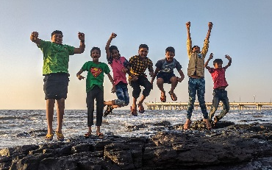
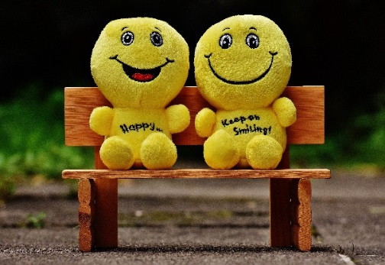
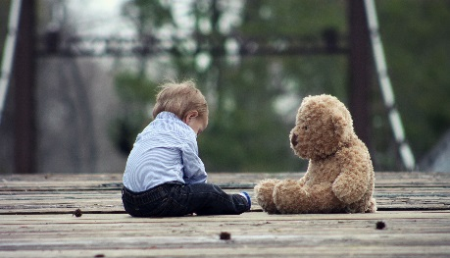
RELATIONSHIPS
Connecting and supporting
Secure and safe
Communicating
Joy and adventure
Nurturing
Equal and caring
Notes:
Slide 6
Ask the pupils to consider what a caring and healthy relationship looks like. Ask for examples and link to prior learning through PSHE / Jigsaw on healthy, respectful relationships.
Each image relates to one of the following. Can they guess which is which?
(scales) Equal and caring – discussing things, making decisions together, being fair
(hands) Connecting and supporting – helping out when things are tough, listening, sticking up for each other, believing in each other
(Smiley faces on a bench) Nurturing – being positive and truthful, addressing differences of opinion without anger, supporting hobbies, taking an interest
(boy and bear) Secure and safe – trusting, truthful, honest, reliable, consistent
(emoji) Communicating – regularly, face to face
(beach children) Joy and adventure – having fun, planning things together, trying new hobbies
Also ask if friendships look like this too? This distinction is important; younger pupils may associate the word relationship with romance and/or marriage.

Slide 7
To say...
Yes, but..!
Notes:
Slide 7
Activity
Thinking about saying yes, but with conditions as mentioned in video clip 1.
Ask children to think about why (or times) someone might say ‘yes’ when they want to say ‘no’ or ‘don’t know’? - Discuss peer pressure and how that can influence giving consent.
Go through some examples when someone might say (or indicate without actually speaking (nod or shake head).....
Yes, but with conditions.
Yes, but I meant no.
Three examples the teacher can give to illustrate the point.
1. Get the class stood up, working from the floor up (i.e. feet first) how might each part of a person’s body look or behave if they were in a situation where they feel like they can’t easily say what their ‘insides’ tell them they want to say. i.e. their toes might be ‘scrunched up’, their feet might be ‘fidgeting’ or moving backwards, away from someone they feel ‘threatened’ by, their legs might feel ‘like jelly’ (because of nervousness), their hands might by trying to hold something for comfort, their head might be down, their eyes might be looking away etc. etc. Then ask them to show examples of how the body might look different if someone was happy and free to say what they wanted to do.
2. Prepare flash cards with these words written on them; enthusiastic, sad, frightened, tired, silly, worried, bored, angry and nervous. The class all stand in a circle and 1 or 2 people are selected to say the word ‘Yes’ in the style of the word on the flash card. Then encourage the children to see that sometimes when the word Yes is used, it doesn’t always show that someone is happy for something to be happening
3. Teacher reads each scenario (or selects one at a time):
a) Your new bestie has come round after school. They ask you to let them use your iPod to send an unkind message to someone in your year who they say has been telling lies about them. They say that unless you let them use your iPod they won’t invite you to their sleepover next weekend.
b) Your best friend has asked you to go to the park with them on Saturday to meet some people they met at a youth club. You know that’s not something you would be allowed to do. Your best friend tells you to just lie about where you’re going. They say that you’re the only one of your friends that won’t be there and that people will make fun of you if they find out you weren’t allowed to go. They then ask you again if you’ll come with them on Saturday.
c) There is a sleepover that you’ve been invited to. You’re really excited as the person who’s having it has a really cool garden with a dog. Your best friend hasn’t been invited. They say they don’t know why you even want to go, saying that it will probably be boring because of who’s going. They ask you not to go, saying that if you say you won’t go they’ll ask their mum if you can both go to the Cinema.
The children are then asked what they think the ‘right’ thing to say would be. They are then asked if there is anything in the situation that would make it harder to say what you WANT to say?

Slide 8
Who you talk to…
Who you meet up with…
Where you go…
When you go out…
POWER
What you do…
What you wear…
Notes:
Slide 8
Ask children to consider the opposite of a healthy, nurturing, respectful, caring, consenting relationship. e.g. an unequal distribution of power and/or an inappropriate relationship.
What does this this look like – behaviours etc.
6 examples are given on the slide.
Ask the question:
Is if fair/healthy that people you have relationships with (romantic, family, friends) can have control or power over you, your decisions, your lifestyle?
Children may use he example of keeping secrets. This is a difficult concept to explain in terms of giving consent to keep a secret. You may want to explain that some secrets may be really harmless, like keeping a surprise party a secret from a family member, whilst other secrets can be unsafe, especially if someone suggests not keeping something a secret will bring harm or is used as a threat. Please use your CP/safeguarding hat here if this discussion arises. Its a bit like the personal safety / stranger danger misconception, in that most harm and abuse is carried out by someone the child knows and not strangers.

Slide 9
WE ALL HAVE THE RIGHT TO FEEL SAFE ALL THE TIME
THERE IS NOTHING SO AWFUL THAT WE CAN’T TALK ABOUT IT WITH SOMEONE
Notes:
Slide 9
Activity
Ask the pupils to consider these two statements:
We all have the right to feel safe (in our relationships) all of the time and
There is nothing so awful that we can’t talk about it with someone.
What do they think about these statements?
Do they agree with them?
What does each one mean to them?
You can emphasise who a child can talk to; HOW they find people to talk to, and that they WON’T be in trouble or get told off, or be accused of lying, if they do speak to someone?

Slide 10
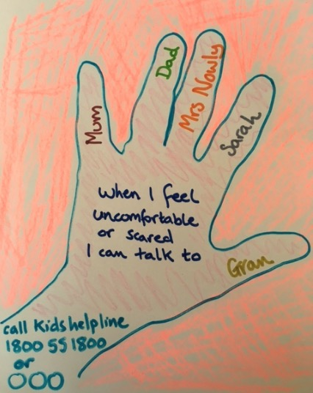
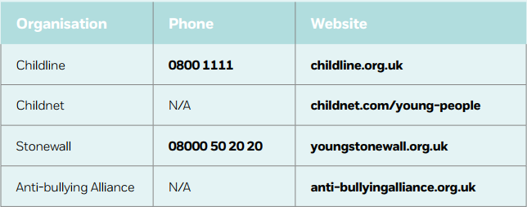
ASKING FOR HELP?
National helplines and websites
My helping hand
Notes:
Slide 10
Finally go through your school’s procedures for who pupil can talk to and where they can get help – what might the barriers be to getting help, either for themselves or a friend?
Activity
Pupils can also create their own helping hand - a list of people to turn to when they are worried or need to talk.
You can add your own school details to this or another slide…. E.g. Class teacher / SENCO / student support / school messaging system / school email address / school health nurse drop-in session etc. for confidential support and advice.

Slide 11
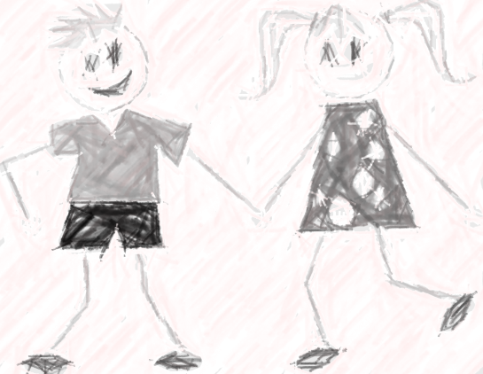
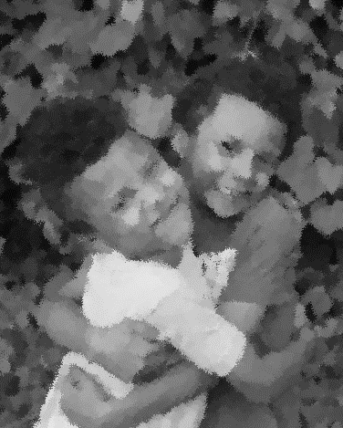
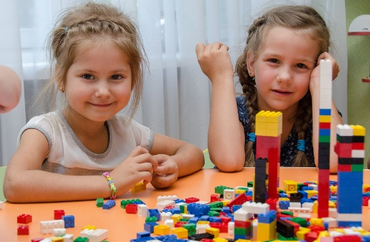
WHAT IS CONSENT?
Notes:
Slide 11
From NSPCC lessons: https://learning.nspcc.org.uk/research-resources/schools/making-sense-relationships/
Recap activity.....
Ask pupils to divide an A4 page into four sections (either using a ruler or by folding) and to write the word consent in the centre of their page. They should then add ideas to the four different sections of their page around the word, using the headings: Synonyms – what other words are related or have a similar meaning? Examples – when might someone need to ask for consent? Context – where have they heard the word used before? Behaviour – how might someone know that someone is giving their consent? (Tip: Think about what the person might say, how they might look or behave).
Understanding consent Ask pupils to create a definition of the word consent by working with a partner and using their synonyms section from the activity above. Ask pupils to feedback their ideas and create a classroom definition of the word ‘consent’ to be displayed in school.
You may want to show this definition of consent afterwards as a comparison: Consent is agreement which is given willingly and freely without exploitation, threat or fear, and by a person who has the capacity to give their agreement.
Encourage pupils to engage with this definition by asking them: • How similar is this to our classroom definition? • What do the words ‘willingly’ and ‘freely’ mean in this definition? • How can we know if consent is willingly and freely given? • What does it mean for someone to have capacity to give their agreement? • Why is someone unable to give consent if they are threatened or afraid? These questions could form part of a whole class or small group discussion, or pupils could reflect on and write their own ideas and responses

Slide 12
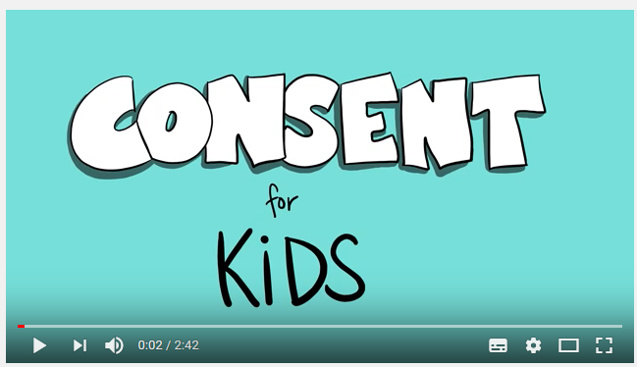
Notes:
Slide 12
Video clip 2 - Consent for kids:
This video is just under 3 minutes and recaps the concept of consent in a simple way. It also starts to develop understanding about consent and harm reduction – using a personal space (this is my body) message. You may want to watch this first.
Please note:
There is a bit in the film where it says ‘ask and listen’. This needs to be rephrased slightly to ‘ask, listen and watch’ – reinforcing that the non-verbal stuff around consent is often more telling than the verbal sounds/words used.

